Slide 1
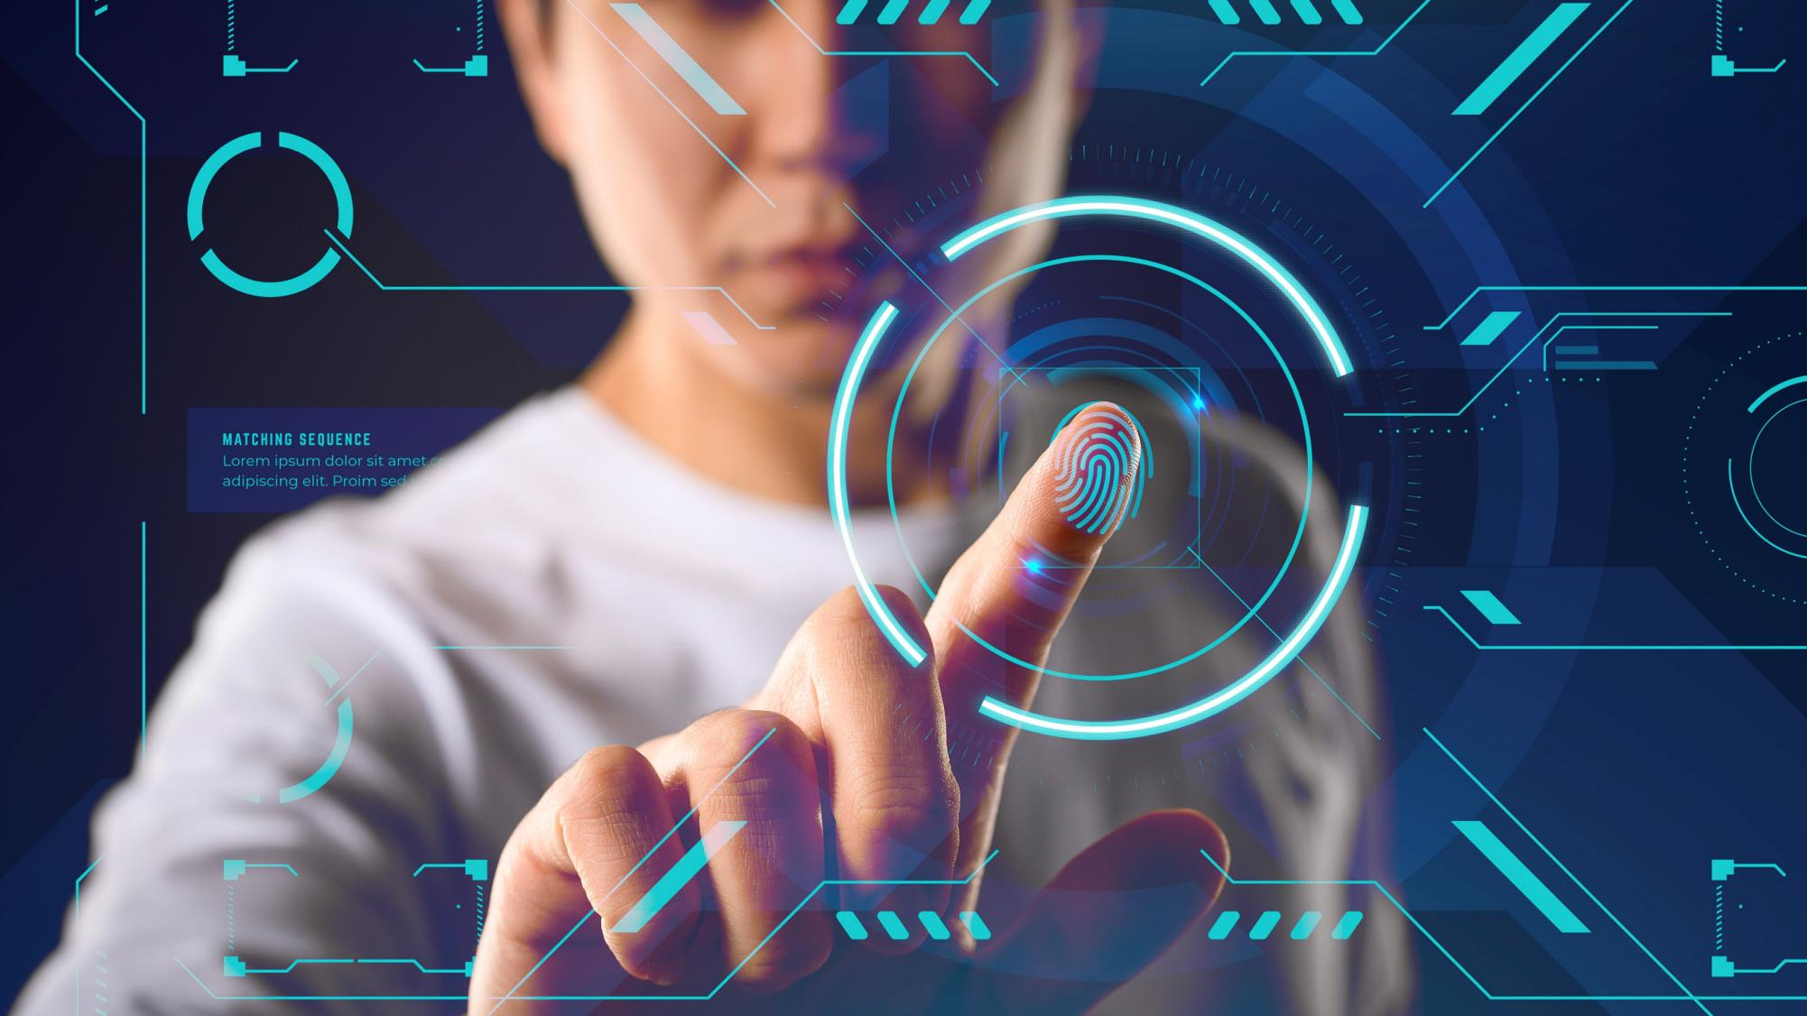

i
SAFE
KLUTCHER

Slide 2
Why Encryption is
important ?
1
For maintaining the security of financial and other R&D data with various internal data which needs to be safe from intruders.
2
To make quick transitions so that private items are not made public.
3
The thief can boot up your computer from a removable device to access your files. Or, they can simply remove the hard disk, install it in another computer, and immediately gain access to all of your files and personal data.
4
But with our product the thief can't gain access to files as they have been encrypted by our encryption algorithm.

Slide 3
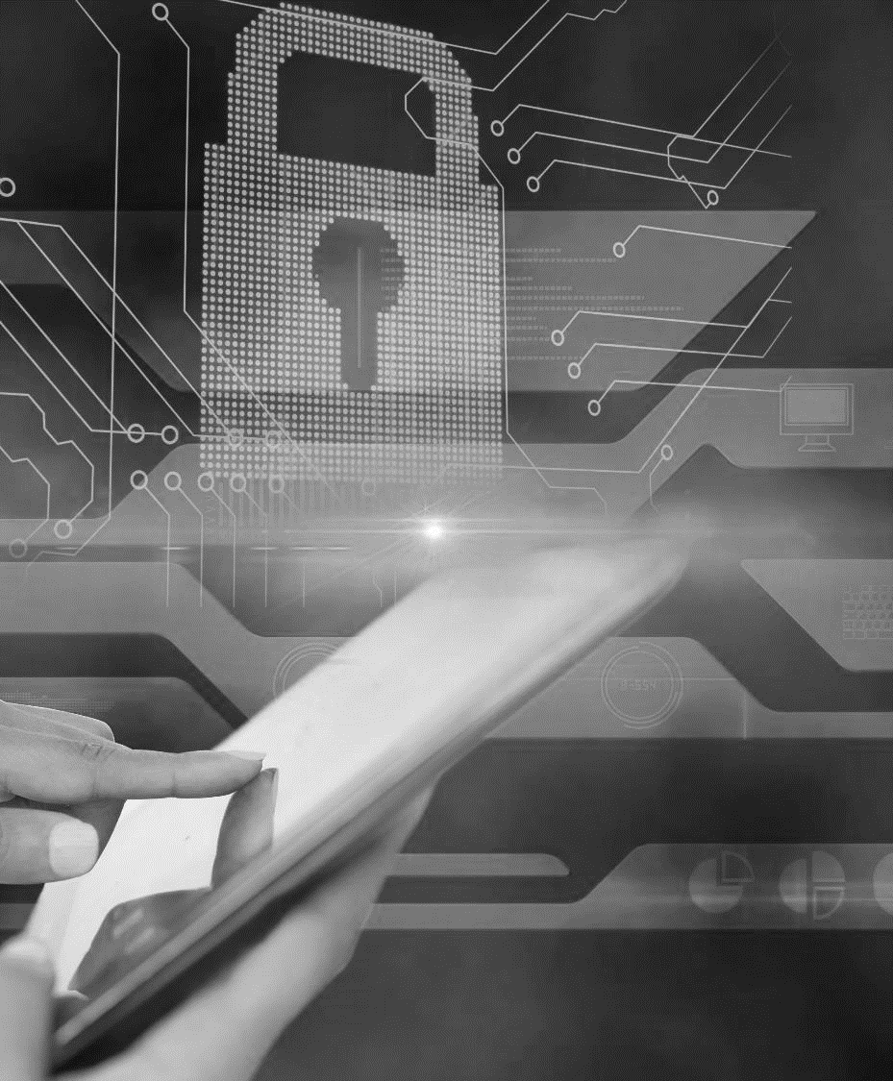
Existing work
The encryption method used in the various available cryptors varies. Many use known algorithms such as AES, RSA, and Blowfish, whereas others use custom algorithms such as Shiva,56 written by Neel Mehta and Shaun Clowes, and ELFcrypt, written by Gregory Panakkal, and cryptelf .
1
2
In 2008, Seagate announced a data encryption technology on their Momentus laptop hard drives that can encrypt drives without the need of software or custom installation.
3
At that time, DELL was interested in using the technology, which provides different levels of security based on whether the use is a home environment or corporate environment.

Slide 4
Proposed
Work
Click to dd text
1
Around the globe, we already have many technologies to encrypt a file with various encryption techniques to provide it high security.
2
So, here we are proposing the encryption of file just like a lock to a door with Hybrid encryption technique so that no one can access the data without authentication.
3
The highlight point of this is if someone enters a wrong password then the system would capture his/her photo. Also if someone enters the wrong password consecutively 3 times within 15 minutes then the file will be locked for 60 minutes.
4
We will also keep records of every login and logout.

Slide 5
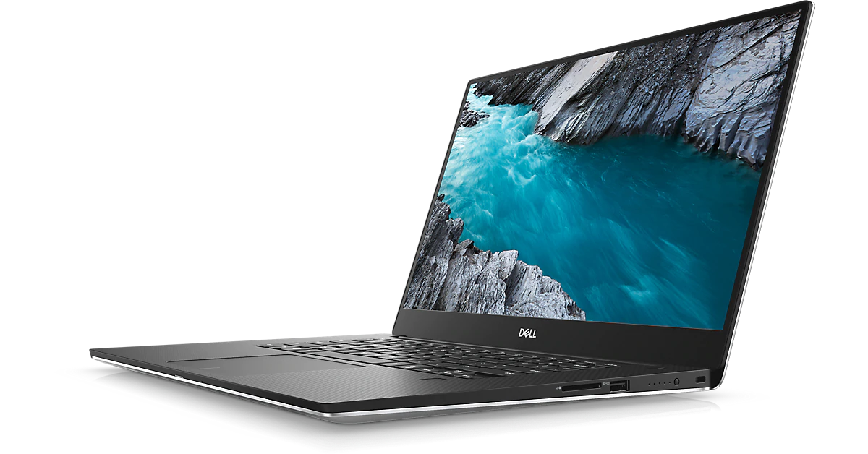

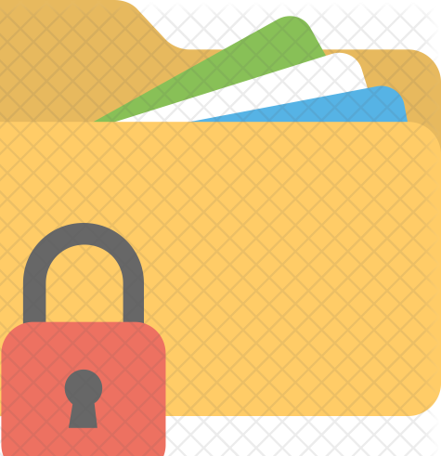
Records every login and logout
Proceed with correct password
Correct Password
User Authenticated
Incorrect Password
More than 3 incorrect password attempts would block file for 60 minutes
Incorrect Password would result in capturing of photo of User

Slide 6
Novelty of
Work
USP
1
Encryption and locking of documents is now a common phenomenon. But can you find out who tried to break into your system when you were not around?? Not really… right?
This is something we tried to introduce with this project. The encryption and locking algorithm is designed to take a snapshot whenever a wrong key to the password field is typed. This will make us aware of the possible suspects in case of frauds and data breaches
2
Another unusual thing we tried to implement is to avoid retrieval of data after formatting by creating it’s image.
There are several well known data retrieval softwares available in market who can tell that what was inside a particular file even after it has been formatted. The algorithm will try to help us out here !!
3

Slide 7
Conclusion
1
The project will have a tracking system which would record the timestamp of every login and logout.
2
If someone tries to gain access by hit and trial methods, the file will get locked for 60 minutes after 3 wrong attempts within 15 minutes of time.
3
The file if once formatted will not be accessible even with the recovery tools available in digital market.
4
So all these features seems to be very powerful and useful to cops if there is some data breach.

Slide 8
References
Cryptography with Python - Quick Guide
Python OpenCV: Capture Video from Camera
File Encryption Decryption Using Python
Locking a file in Python

Slide 9
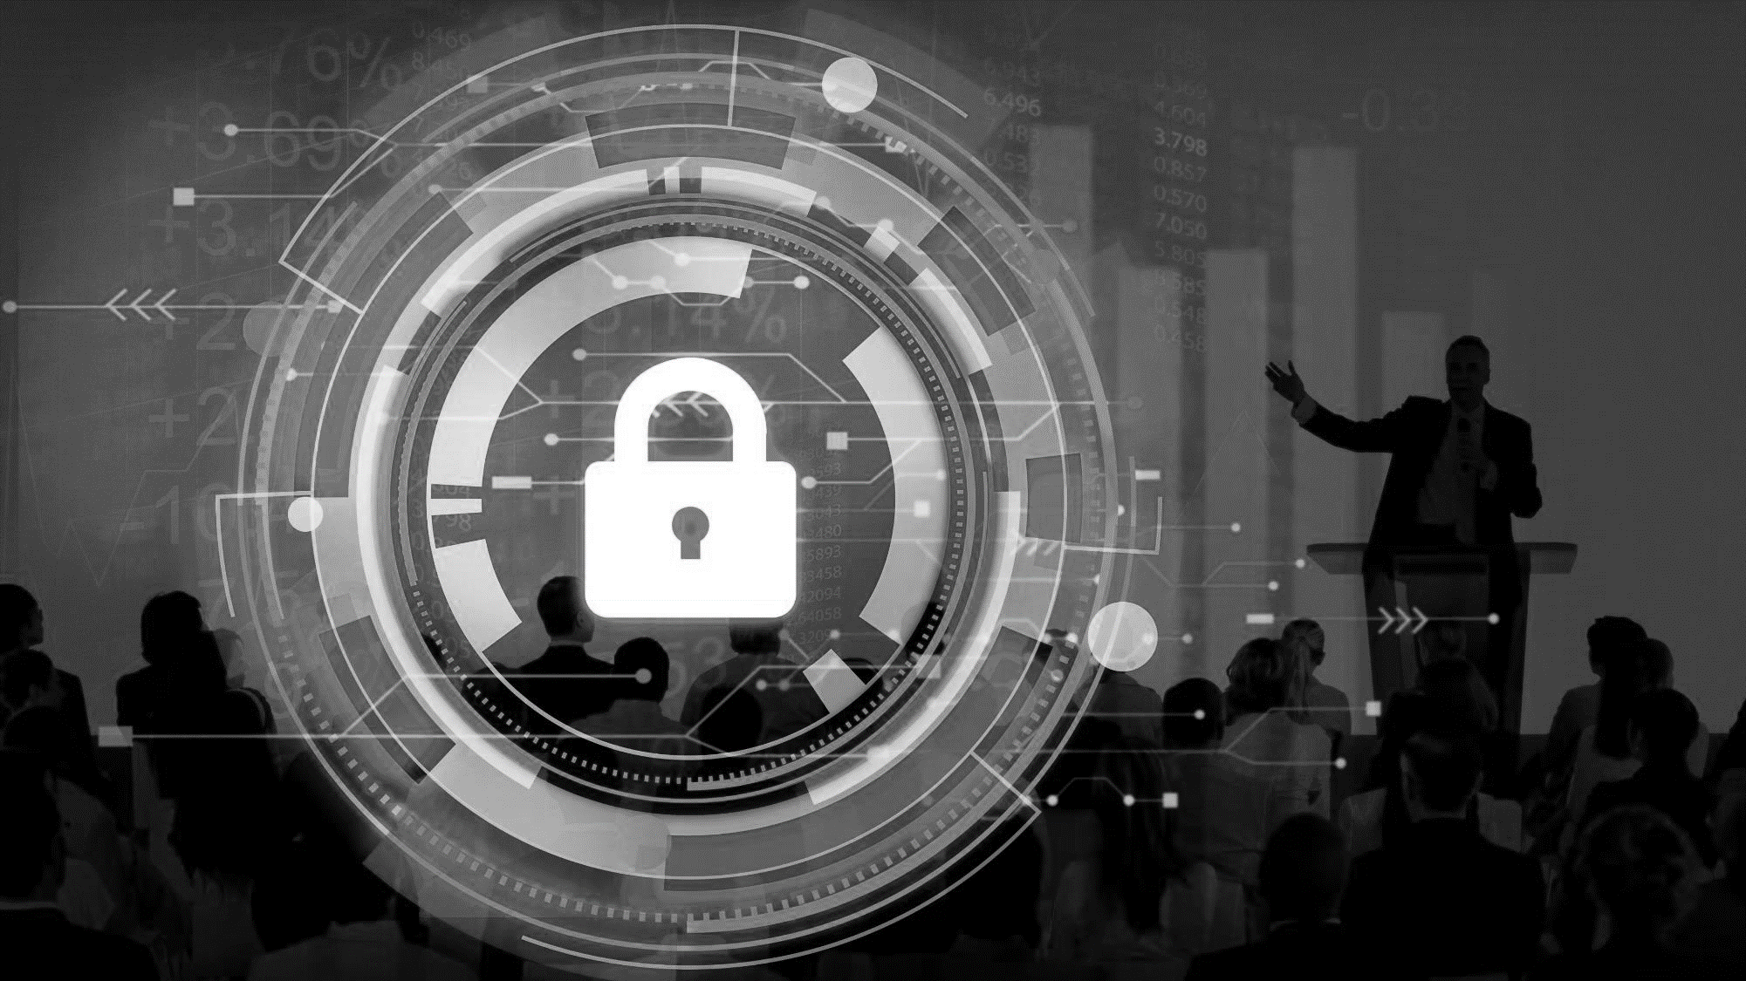
THANK YOU
Group - Cyber 07
Adnan Khan - 19bcy10051
Saloni Gupta - 19bcy10007
Priya Sharma - 19bcy10077
Vipul Jaiswal - 19bcy10016

